Slide 1
IDP Group-8
Hardware Presentation

Slide 2
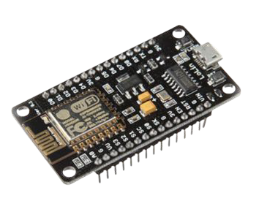
NodeMcu V3 ESP8266 WIFI Module Development Board with CH340
NodeMCU is an open source platform based on ESP8266 which can connect objects and let data transfer using the Wi-Fi protocol.
Features:
Open-source platform
Interactive & Programmable
WiFi enabled
Arduino-like Hardware IO
Nodejs style network API
ESP8266, a low cost WiFi module on-board (FCC Certified)
On-board USB-TTL converter, plug & play
Price: 330 Tk.

Slide 3
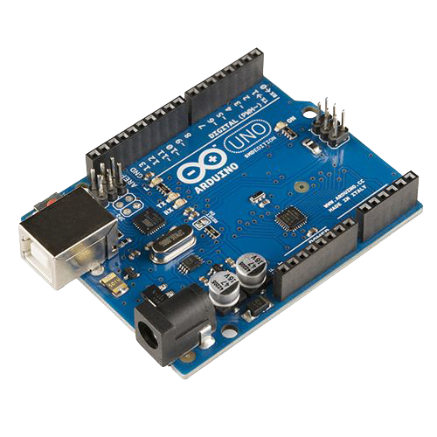
Arduino Uno R3
The Arduino Uno R3 is a microcontroller board based on a removable, dual-inline-package (DIP) ATmega328 AVR microcontroller. It has 20 digital input/output pins (of which 6 can be used as PWM outputs and 6 can be used as analog inputs). Programs can be loaded onto it from the easy-to-use Arduino computer program.
Features:
Microcontroller board based on the ATmega328
The Arduino Uno has 14 digital input/output pins
Operating Voltage: 5V
Input Voltage (recommended): 7-12V
Price: 950 Tk.

Slide 4
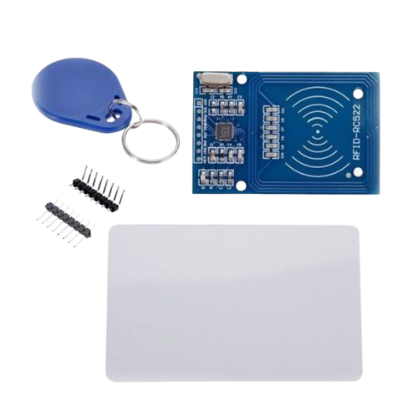
RFID-RC522 RF IC Card Sensor Module
RC522 is the highly integrated RFID card reader which works on non-contact 13.56mhz communication, is designed by NXP as low power consumption, low cost and compact size read and write chip, is the best choice in the development of smart meters and portable hand-held devices
Features:
Integrated MF RC522
13.56MHz contactless communication card chip.
The low-voltage, low-cost, small size of the non-contact card chip to read and write.
Suitable for Smart meters and portable handheld devices.
Advanced modulation and demodulation concept completely integrated into all types of 13.56MHz passive contactless communication methods and protocols
Price: 165 Tk.

Slide 5
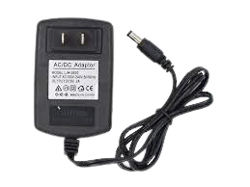
DC 9V 2A Adapter Power Supply
The adaptor converts AC wall power to 9-volt DC for powering most instrument pedals and other 9-volt battery devices.
Features:
Built-in over voltage, over current, and short circuit protection
PWM design, make sure the stability and high efficiency of power supply.
Anti-jamming, passed EMC test, wave less than 20MV.
Constant voltage output, assume stable power supply for LED lightings to reach long lifetime
Price: 211 Tk.

Slide 6
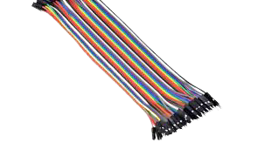
Male-Male Jumper Wire
Jumper wires are simply wires that have connector pins at each end, allowing them to be used to connect two points to each other without soldering.
Features:
typically used with breadboards and other prototyping tools
Very Simple.
Price: 2.50 Tk (Per Wire).

Slide 7
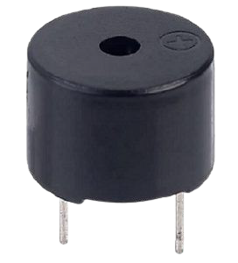
Buzzer Sensor
An audio signaling device like a beeper or buzzer may be electromechanical or piezoelectric or mechanical type. The main function of this is to convert the signal from audio to sound. Generally, it is powered through DC voltage and used in timers, alarm devices, printers, alarms, computers, etc. Based on the various designs, it can generate different sounds like alarm, music, bell & siren.
Features:
Simply Compatible
Frequency Response is Good
Size is small
Energy Consumption is less
The Range of Voltage usage is Large
Sound Pressure is high
Price: 15 Tk.

Slide 8
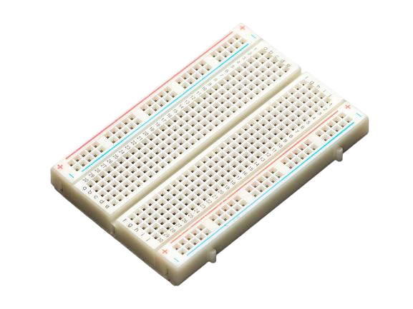
Breadboard
A breadboard allows for easy and quick creation of temporary electronic circuits or to carry out experiments with circuit design.
Features:
Distribution Strips are two.
Wire Size is 21 to 26 AWG wire.
Tie Points are two hundred.
Withstanding Voltage is 1,000V AC.
Tie points within IC are 630.
Insulation Resistance is DC500V or 500MΩ
Price: 79 Tk.

Slide 9
Thank You!

